Slide 1
Menghindari Plagiasi dan Menuliskan Sitasi dengan Baik
Burhanuddin Halimi
Kamis, 26 November 2015
Ruang Sidang II, Gedung dr Prakosa Rektorat UNS

Slide 2
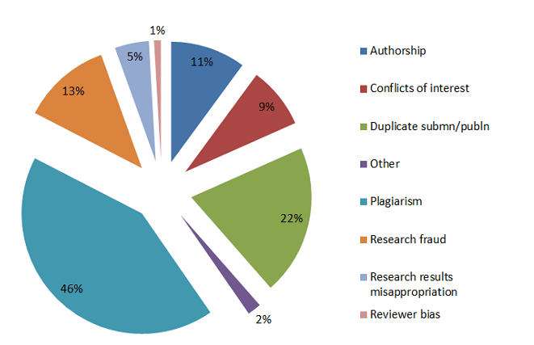
Plagiarism: high amongst ethics issues
Source:
E. Presani, How to write a great research paper

Slide 3
Plagiarism definition
”Plagiarism is the use of another’s thoughts, or work, without acknowledgement or permission. In plagiarism, one author takes another’s idea and presents it as his/her own.” (Smith & Wren 2010)
“Plagiarism originated from the Latin word plagiarius meaning the theft of words as well as slaves” (Gu & Brooks, 2008)
“The word plagiarism comes from Latin word plagium which means kidnapping” (Imran, 2010)
Source:
T. Niklander, How to avoid plagiarism?
N. Smith & K. Wren: Ethical and Legal Aspects Part 2: Plagiarism—‘‘What Is It and How Do I Avoid It?’’.
Q. Gu & J. Brooks: Beyond the accusation of plagiarism.
N. Imran: Electronic Media, Creativity and Plagiarism.

Slide 4
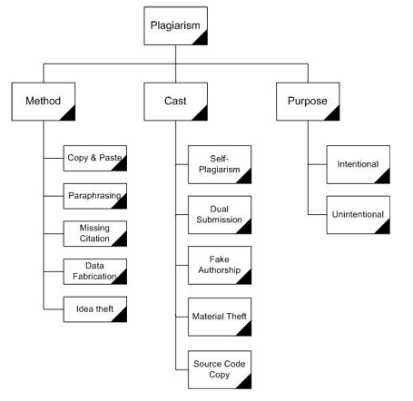
Types of plagiarism in research
Method
how it is implemented
Cast
the form of plagiarism
Purpose
the motivation behind
Source:
T. Niklander, How to avoid plagiarism?.
N. Imran: Electronic Media, Creativity and Plagiarism.

Slide 5
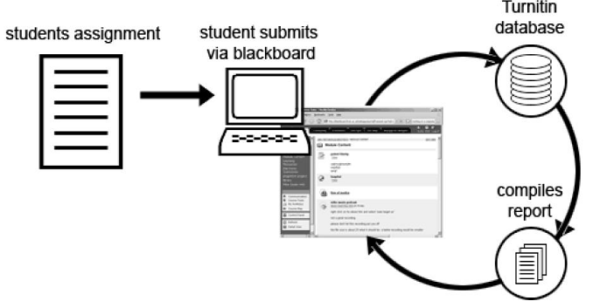
Plagiarism detection tools
Turnitin
CrossCheck™ Powered by iThenticate
Plagiarisma.net
Source:
T. Niklander, How to avoid plagiarism?.

Slide 6
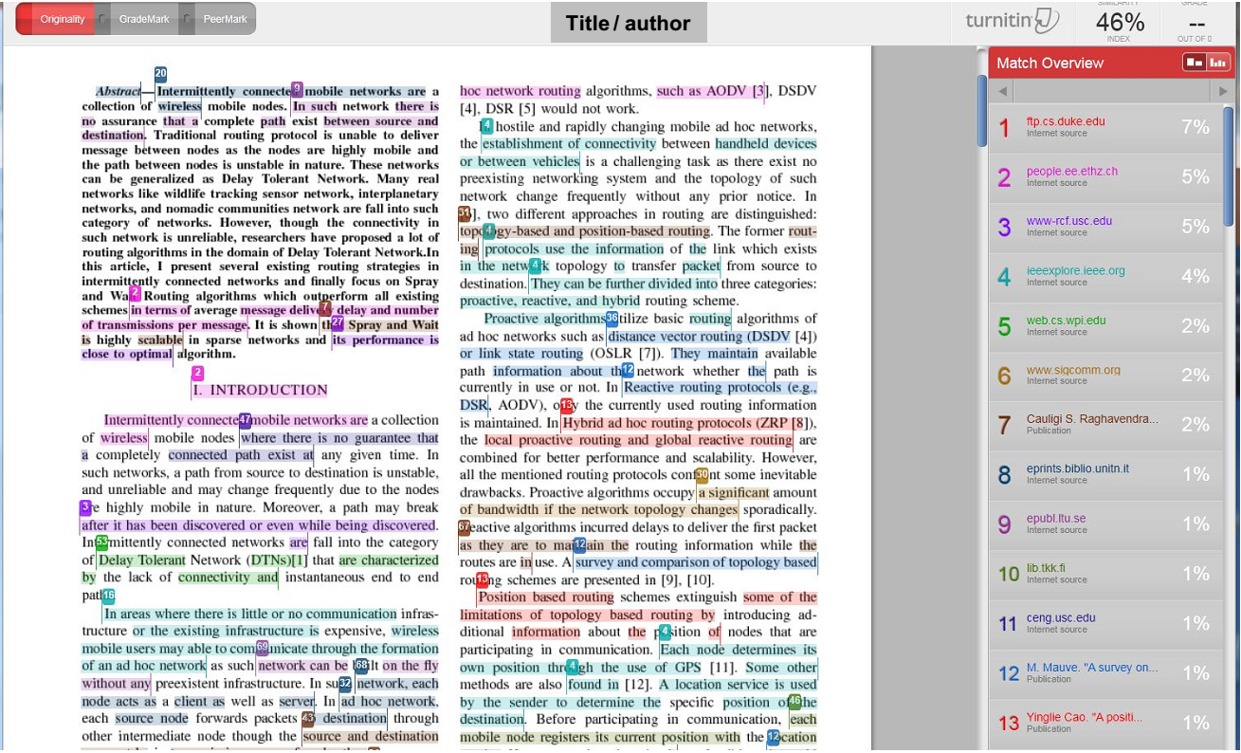
Source:
T. Niklander, How to avoid plagiarism?.

Slide 7
How to avoid?
“Avoiding plagiarism does not need to be difficult or require an in-depth knowledge of copyright law.” (Smith&Wren 2010)
Use proper referencing
Paraphrase properly
Summarize in own voice (with citation)
Understand the source information (Imran 2010)
Source:
T. Niklander, How to avoid plagiarism?
N. Smith & K. Wren: Ethical and Legal Aspects Part 2: Plagiarism—‘‘What Is It and How Do I Avoid It?’’.
N. Imran: Electronic Media, Creativity and Plagiarism.

Slide 8
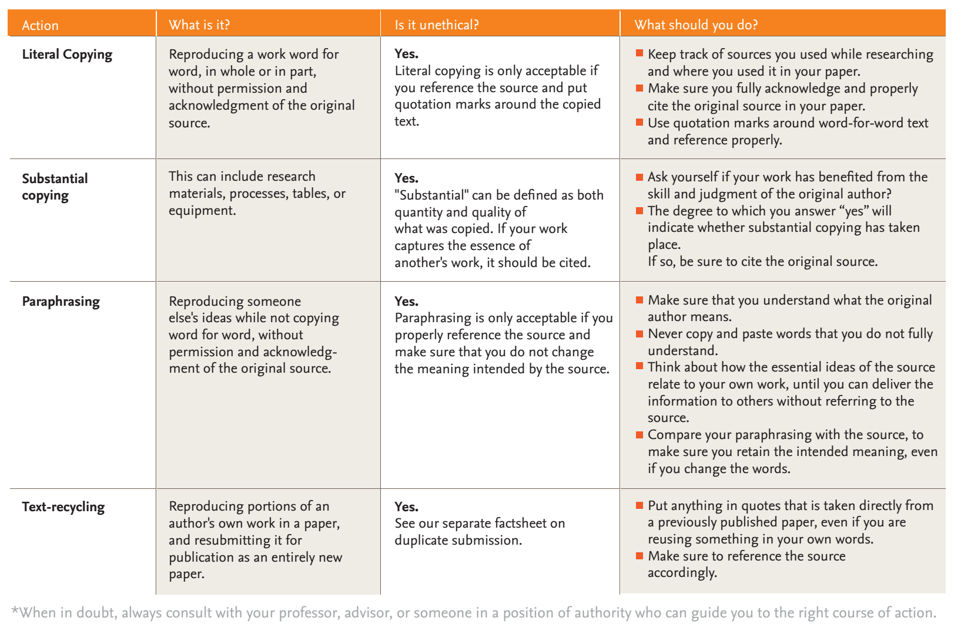
Guide to Plagiarism and How to Prevent It*
Source: Ethics in Research & Publication, Elsevier

Slide 9
Paraphrases–Unsuccessful and Successful
Paraphrasing is often defined as putting a passage from anauthor into “your own words.”
Source:
The Writing Center, 6171 White Hall, UW-Madison

Slide 10
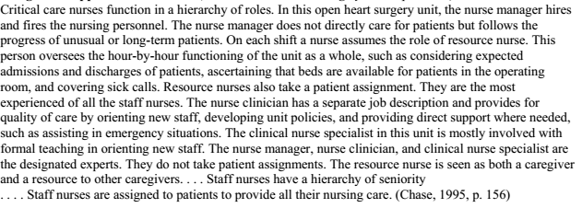
Critical care nurses have a hierarchy of roles. The nurse manager hires and fires nurses. S/he does not directly care for patients but does follow unusual or long-term cases. ….
Source:
The Writing Center, 6171 White Hall, UW-Madison

Slide 11
How to Paraphrase
When reading a passage, try first to understand it as a whole, rather than pausing to write down specific ideas or phrases.
Be selective. Unless your assignment is to do a formal or “literal” paraphrase,* you usually don’t need to paraphrase an entire passage; instead, choose and summarize the material that helps you make a point in your paper.
Think of what “your own words” would be if you were telling someone who’s unfamiliar with your subject (your mother, your brother, a friend)what the original source said.
Remember that you can use direct quotations of phrases from the original within your paraphrase, and that you don’t need to change or put quotation marks around shared language (see box above)
Source:
The Writing Center, 6171 White Hall, UW-Madison

Slide 12
Methods of Paraphrasing
Look away from the source; then write
Take notes.
While looking at the source, first change the structure, then the words.
Source:
The Writing Center, 6171 White Hall, UW-Madison

Slide 13
Using Direct Quotations
Use direct quotations only if you have a good reason.
Most of your paper should be in your own words
Reasons for Quoting
To show that an authority supports your
To present a position or argument to critique or comment on
To include especially moving or historically significant language
To present a particularly well-stated passage whose meaning would be lost or changed if paraphrased or summarized
Source:
The Writing Center, 6171 White Hall, UW-Madison

Slide 14
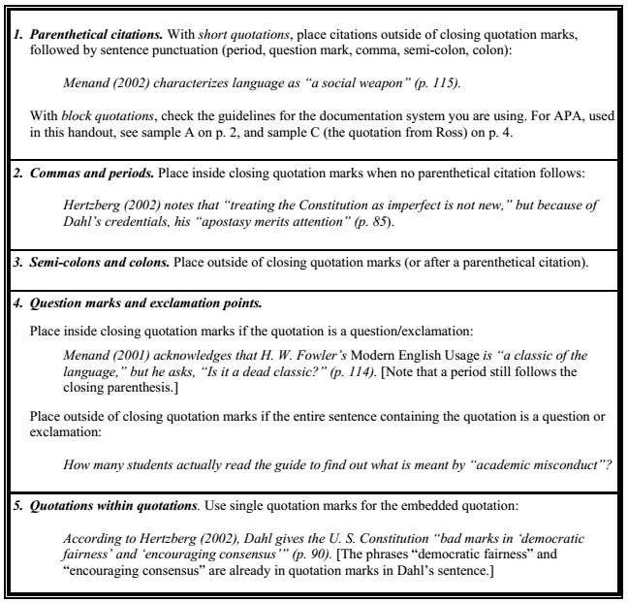
Punctuation with Quotation Marks

Slide 15
Key points
Common sense
Do not steal ideas
Give credit to the right persons and papers
Tools help teachers in checking
Source:
T. Niklander, How to avoid plagiarism?

Slide 16
Some Useful Sources
American heritage dictionary of the English language(4th ed.). (2000). Retrieved January 7, 2002, from http://www.bartleby.com/61/
Bazerman, C. (1995). The informed writer: Using sources in the disciplines(5th ed). Boston: Houghton Mifflin.
Leki, I. (1995). Academic writing: Exploring processes and strategies (2nd ed.) New York: St. Martin’s Press, pp. 185-211. Leki describes the basic method presented in C, pp. 4-5.
Spatt, B. (1999). Writing from sources(5th ed.) New York: St. Martin’s Press, pp. 98-119; 364-371.
Source:
The Writing Center, 6171 White Hall, UW-Madison

Slide 17
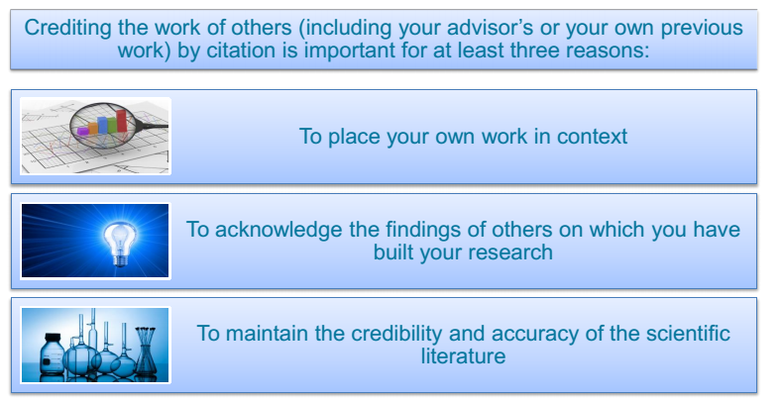
Correct citation is key

Slide 18
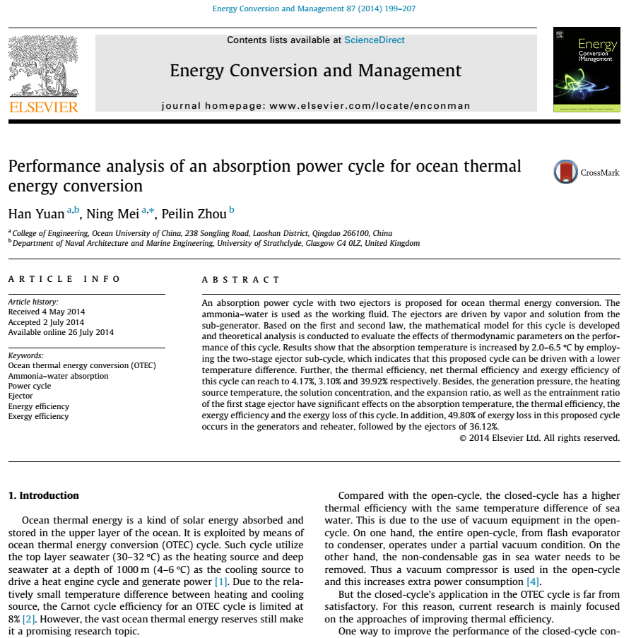
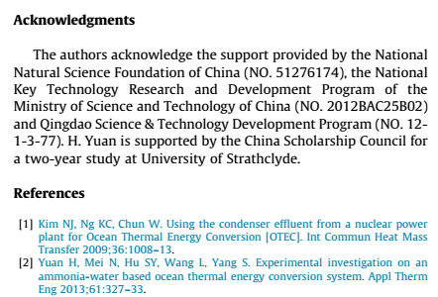
Citation

Slide 19
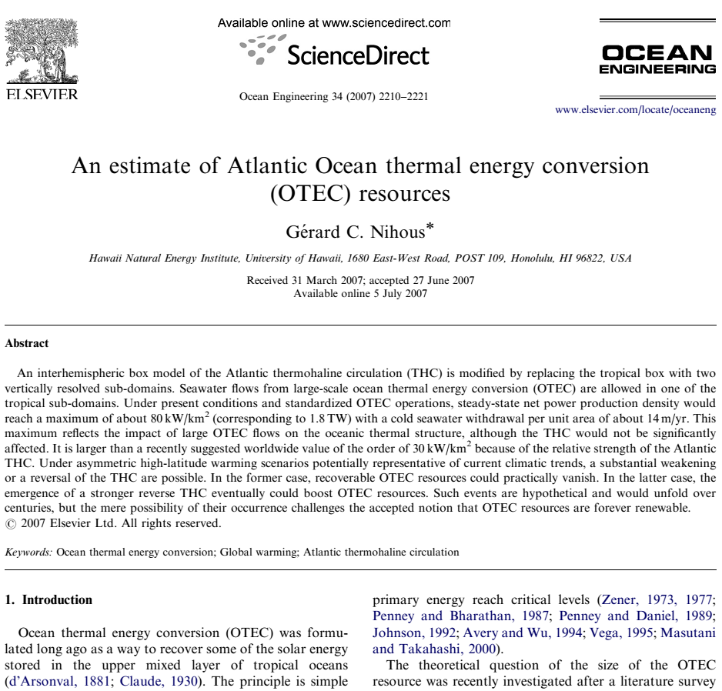
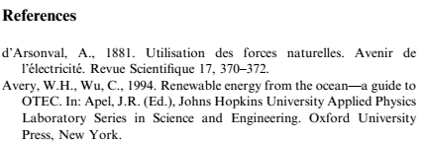
Citation

Slide 20
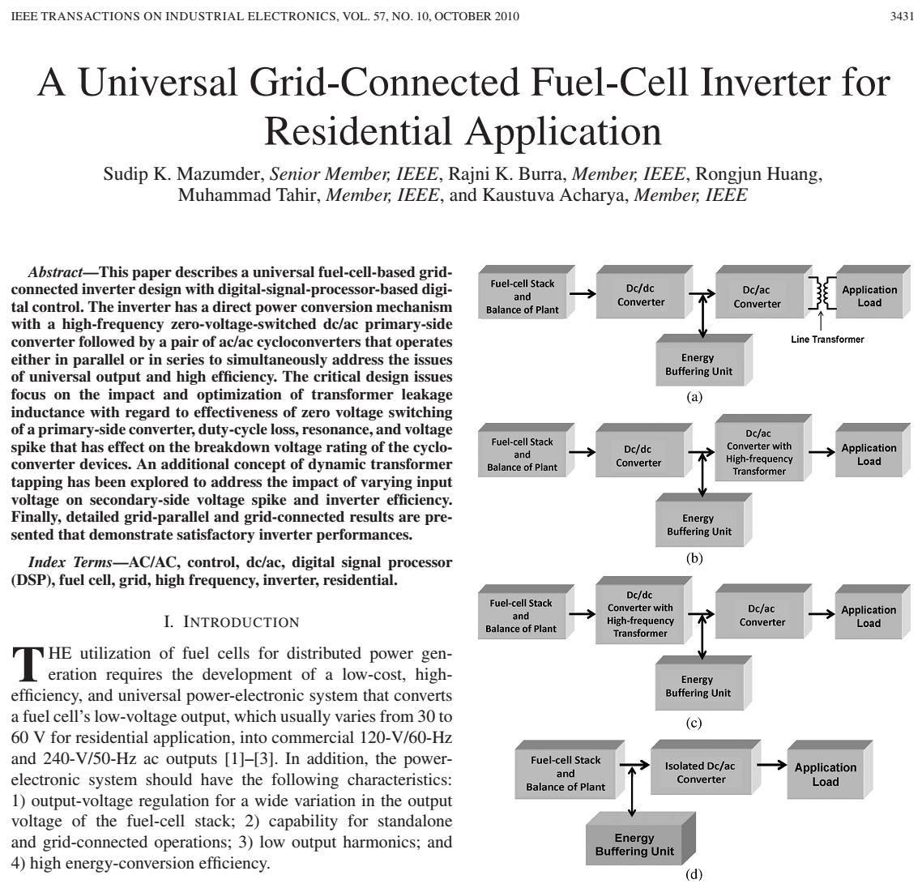
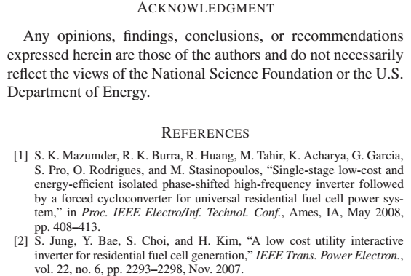
Citation

Slide 21
Referencing your sources
In higher education when ever you include a fact or piece of information in an assignment or essay you must also include where and how you found that piece of information. Even if you 'just know it' - it has to have come from somewhere. This is because in higher education assignment writing you are not just being tested on what you know, but rather what you are able to find out and what you think it means.
Details about where you found the information utilised to write your assignment are kept in two chapters right at the very end, called the reference list and bibliography. The reference list is where you list the direct quotes or paraphrased findings of another author. The bibliography is where you list sources you've read for background information, but did not directly include in your work. In addition, a small mention to the author and publish year, within brackets, must be given in the main body of your assignment wherever you make a reference.
Referencing Styles
To make the reference list and bibliography consistent and easy to read across different papers there are predefined styles stating how to set them out - these are called citation styles. Different subjects prefer to each use different styles. The following are the most popular:
APA. APA is an author/date based style. This means emphasis is placed on the author and the date of a piece of work to uniquely identify it.
MLA. MLA is most often applied by the arts and humanities, particularly in the USA. It is arguably the most well used of all of the citation styles.
Harvard. Harvard is very similar to APA. Where APA is primarily used in the USA, Harvard referencing is the most well used referencing style in the UK and Australia, and is encouraged for use with the humanities.
Vancouver. The Vancouver system is mainly used in medical and scientific papers.
Chicago and Turabian. These are two separate styles but are very similar, just like Harvard and APA. These are widely used for history and economics.

Slide 22
The Best Online Bibliography and Citation Tools
Bibme - Free
Citefast - Free
Citelighter - Free
Oregon Public Education Citation Maker for MLA - Free
RefDot - Chrome Extension - Free
Zotero - Free
Easy Bib - MLA Free
EndNote
EndNote enables you to move seamlessly through your research process with flexible tools for searching, organizing and sharing your research, creating your bibliography and writing your paper. You'll save hours building and maintaining reference libraries and creating bibliographies. With unique features to maximize your time like automatically finding full text and updating records, EndNote lets you spend less time in the details.
NoodleTools
RefWorks

